Slide 1

Distance Sensing Robot with Voice Control
Chinmay Galande, Anirudh Arunkumar, Sufiyan Ahmed, Ashwin Kulkarni
ECE 4180 Final Project
Georgia Institute of Technology

Slide 2

Introduction
The robot is able to take voice commands from any android using an app developed with MIT Inventor via bluetooth

Slide 3
Functionality
Autonomous mode (Say “Autonomous”)
Distance read via the ultrasonic sensor on the front
If an obstacle is detected within ~25cm, it will stop, turn until there is no longer an obstacle, and then start moving forward again.
Speaker “beeps” when moving backwards
LCD shows that it is in Autonomous mode
Voice mode (Say “Bluetooth”)
Drive forward, backward, and turn via voice commands.
LCD shows direction of movement.
Speaker “beeps” when moving backwards

Slide 4
Parts List
Mbed LPC1768: https://www.sparkfun.com/products/9564
HC05 Bluetooth Module: https://a.co/d/0m9C4Wu
Jumper Wires: https://www.sparkfun.com/products/124, https://www.sparkfun.com/products/11026, https://www.sparkfun.com/products/12794
Ultrasonic Sensor (HC-SR04): https://www.digikey.com/en/products/detail/osepp-electronics-ltd/HC-SR04/11198533
H-Bridge (SparkFun Motor Driver): https://www.sparkfun.com/products/14450
uLCD-144-G2 128: https://www.sparkfun.com/products/11377
Speaker: https://www.sparkfun.com/products/11089
DC Motor (DG01D) x2: https://www.sparkfun.com/products/13302
Rubber Wheels x2: https://www.sparkfun.com/products/13259
Shadow Chassis: https://www.sparkfun.com/products/13301
AAA Batteries x4: https://a.co/d/3kETYpp

Slide 5
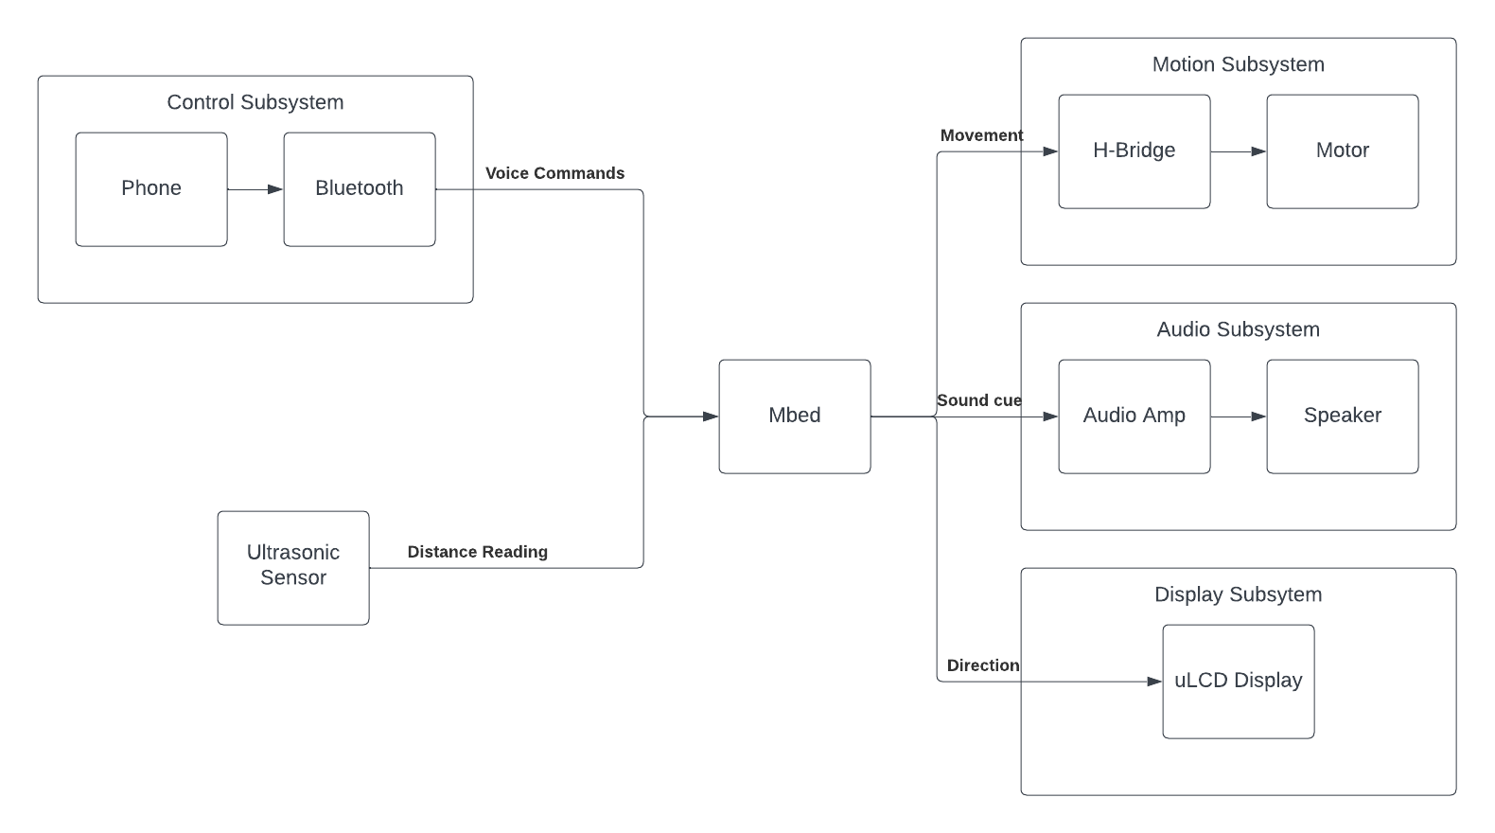
Block Diagram

Slide 6
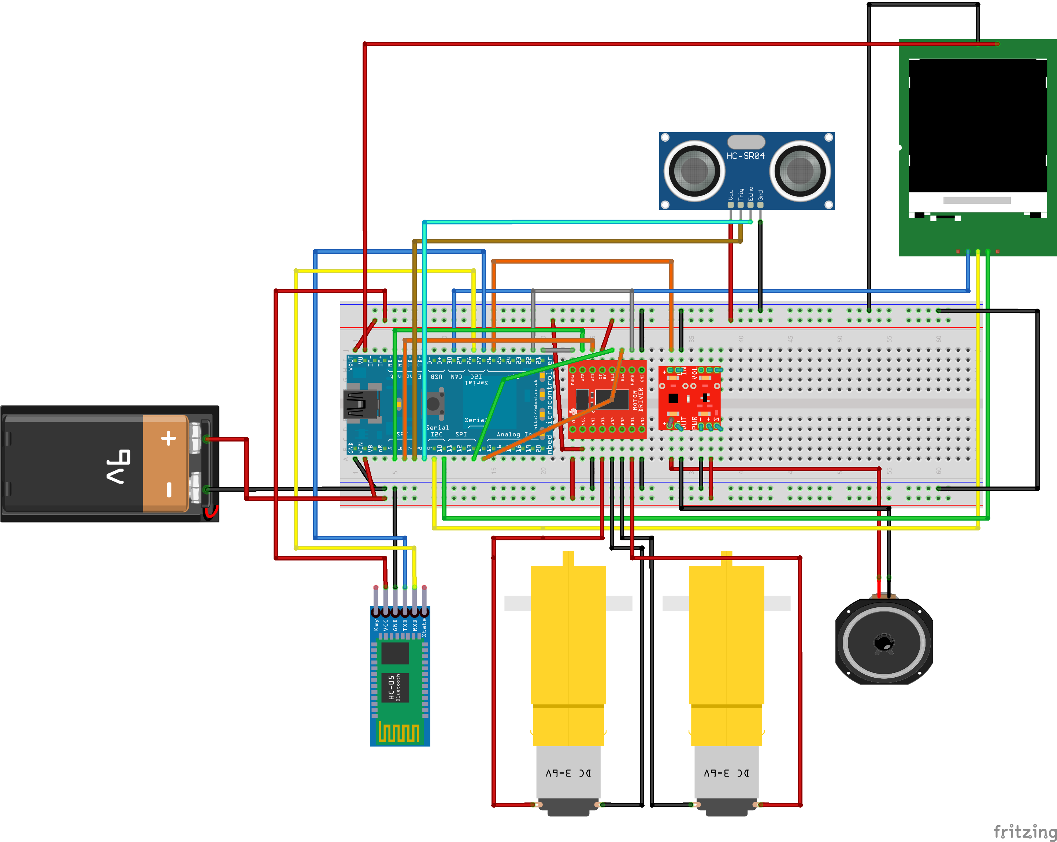
Schematic

Slide 7
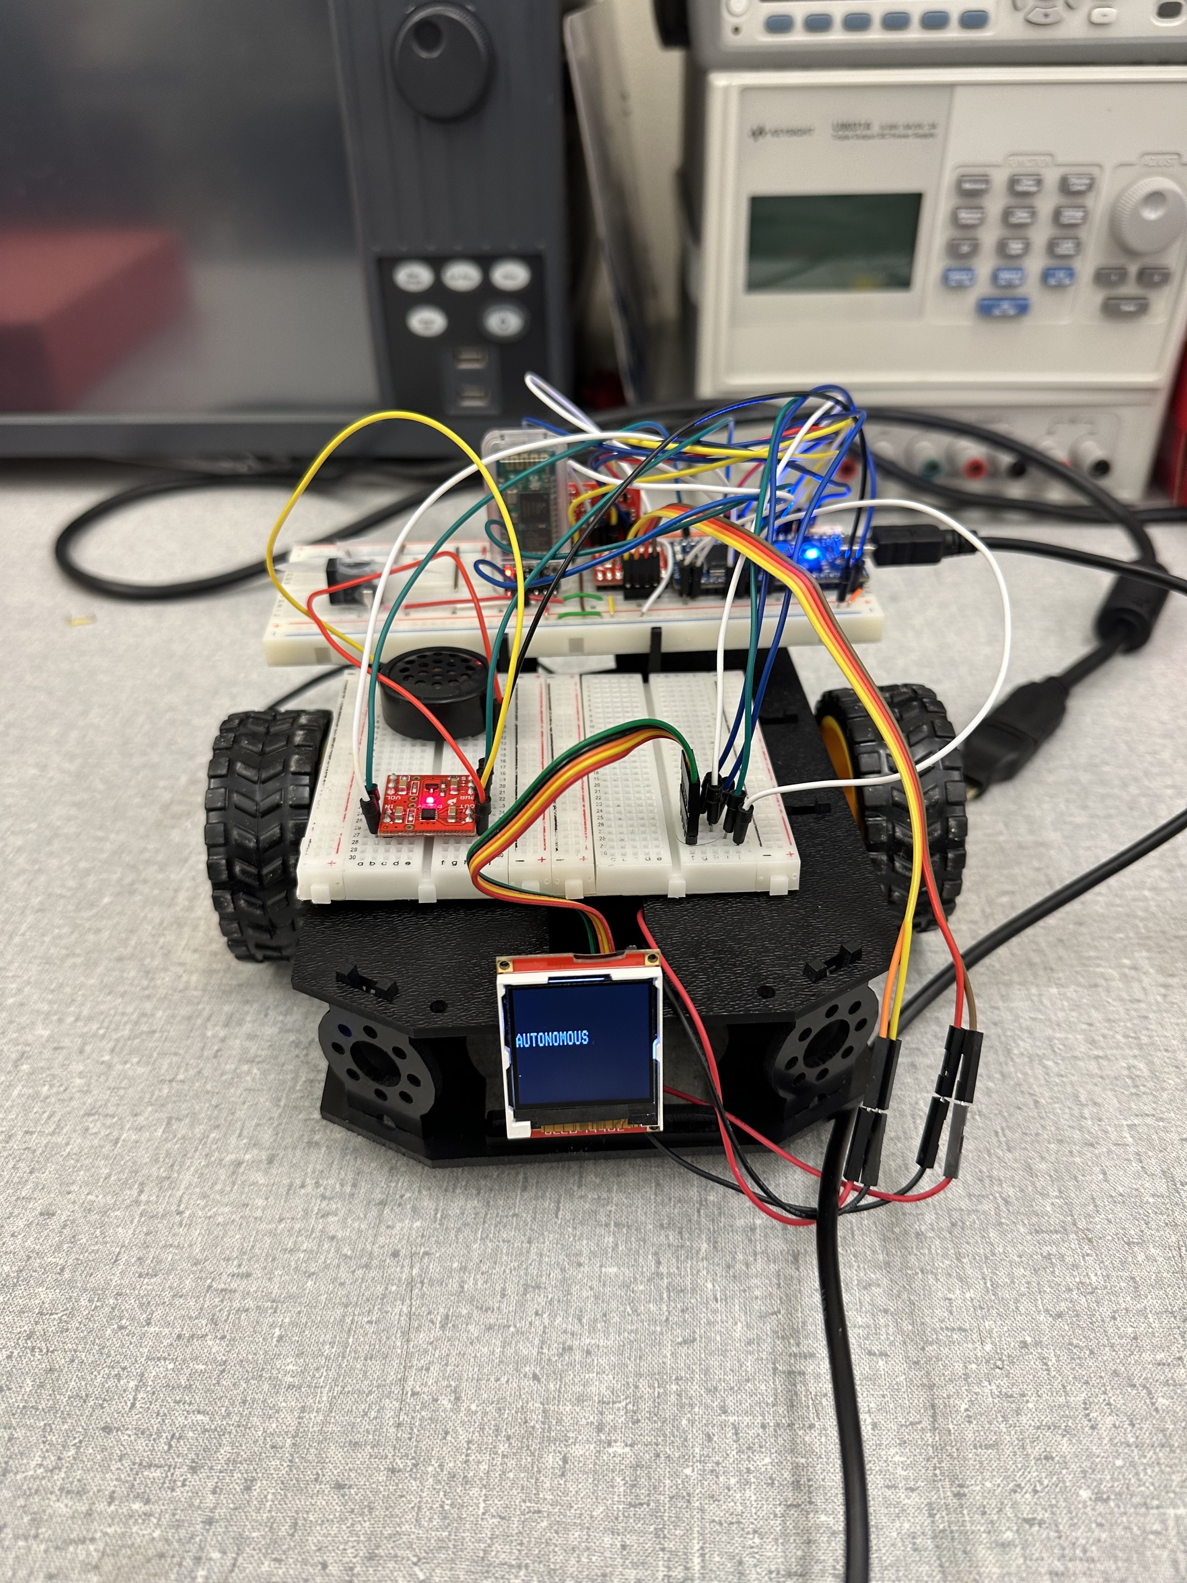
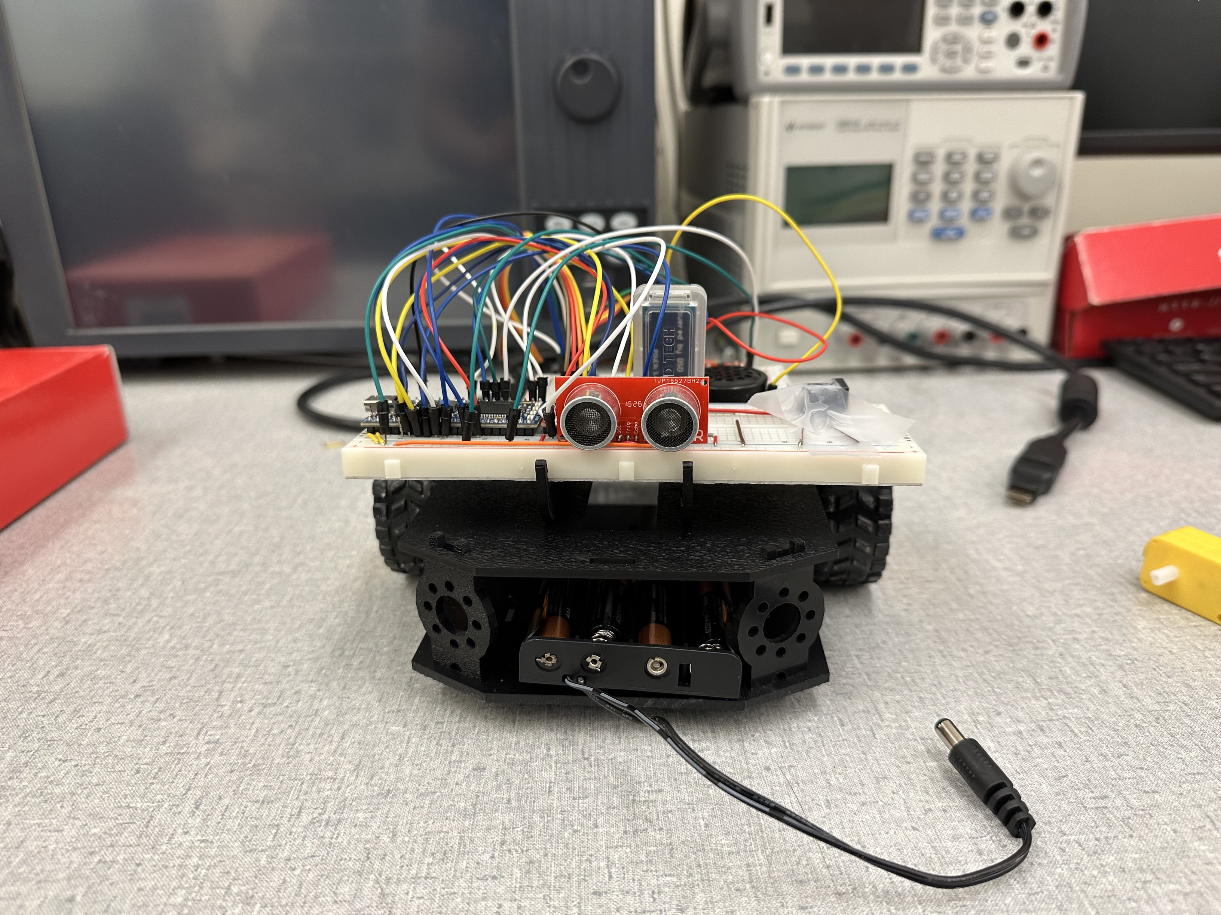
Picture of the Robot

Slide 8
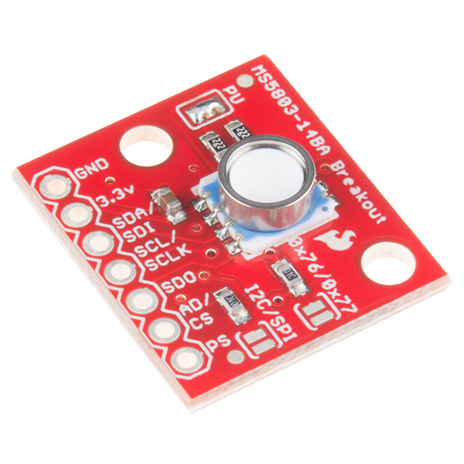
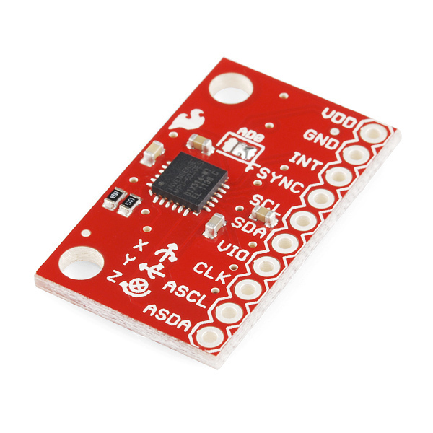
Conclusion & Future Direction

